Slide 1

Meridian House — Renovation Proposal
A full renovation of the existing structure, preserving the original massing while opening the ground floor to natural light.
Kestrel Studio

Slide 2
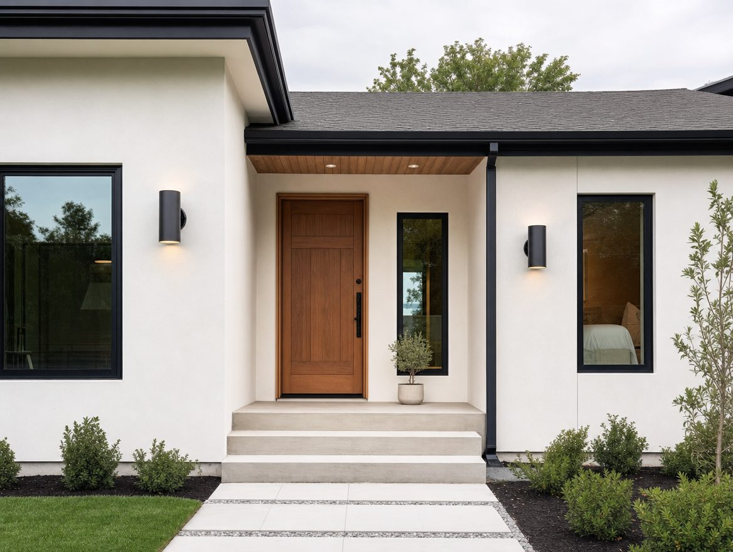
Entrance
Kestrel Studio

Slide 3
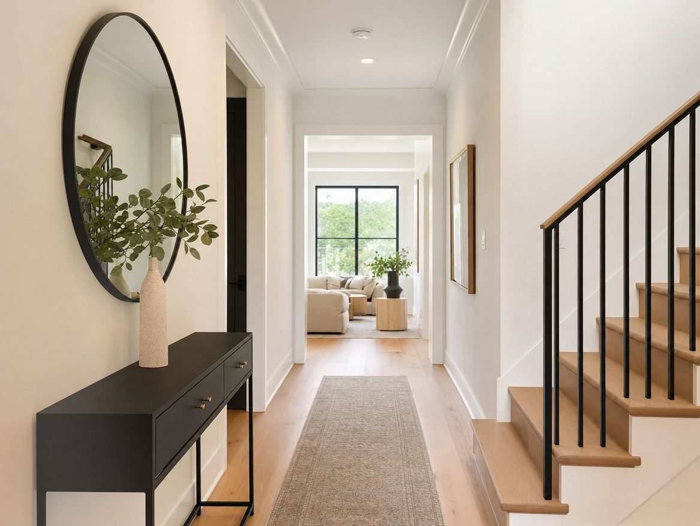
Hallway
Kestrel Studio

Slide 4
Timeline & budget
Demolition and structural work: weeks 1-6
Systems (electrical, plumbing): weeks 5-10
Finishes and closeout: weeks 10-14
Total budget: $221,000, see Renovation budget.xlsx for the line-item breakdown
Kestrel Studio

